Slide 1
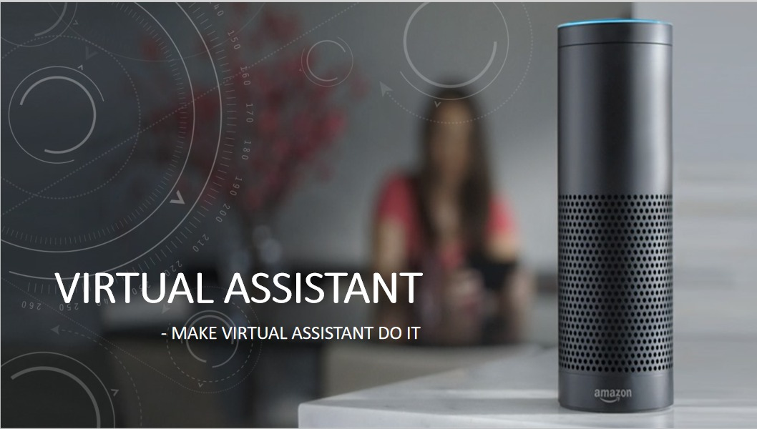

Slide 2
INTRODUCTION TO VIRTUAL ASSISTANT
A virtual assistant, also called AI assistant or digital assistant, is an application program that understands natural language voice commands and completes tasks for the user.
Such tasks, historically performed by a personal assistant or secretary, include taking dictation, reading text or email messages aloud, looking up phone numbers, scheduling, placing phone calls and reminding the end user about appointments.
Popular virtual assistants currently include Amazon Alexa, Apple's Siri, Google Assistant and Microsoft's Cortana

Slide 3
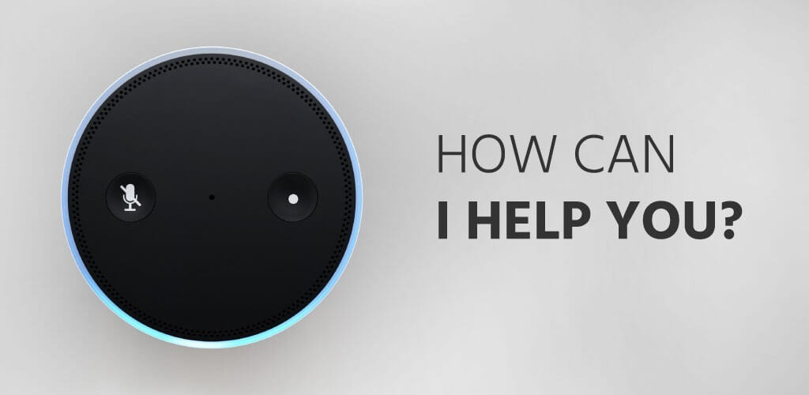
Virtual assistants typically perform simple jobs for end users, such as adding tasks to a calendar; providing information that would normally be searched in a web browser; or controlling and checking the status of smart home devices, including lights, cameras and thermostats.

Slide 4

ADVANTAGES OF VIRTUTAL ASSISTANT
Time, the most important asset of everyone and it save most of it.
Performs administrative tasks.
Scalability
Reduces Human work
Increase Productivity
Access to different skills sets

Slide 5

Project Management
Presentation
Project Structure
Flow Of Our Project
Software Requirements
Development
Testing & Implementation

Slide 6
Flow Of Our Project

Slide 7

FLOWCHART
Search from web browser
VOICE INPUT
User
Virtual Assistant
Performs the task
Process the result from the browser
Converts Voice to Text

Slide 8

Tasks perform by our virtual Assistant :-
Speech Recognition
Converts Voice To Text
Tells Time And Date Whenever We Ask
Plays Your Desired Song
Can Tell Humorous Jokes
Can Extract Information From Wikipedia
Can tell you information about today’s weather
Can take a photo
Can take a video
Can do simple calculations
Sends a message if you need to
You can play games like Chess and Ludo
Shows the device’s current IP address

Slide 9
Software Requirements

Slide 10
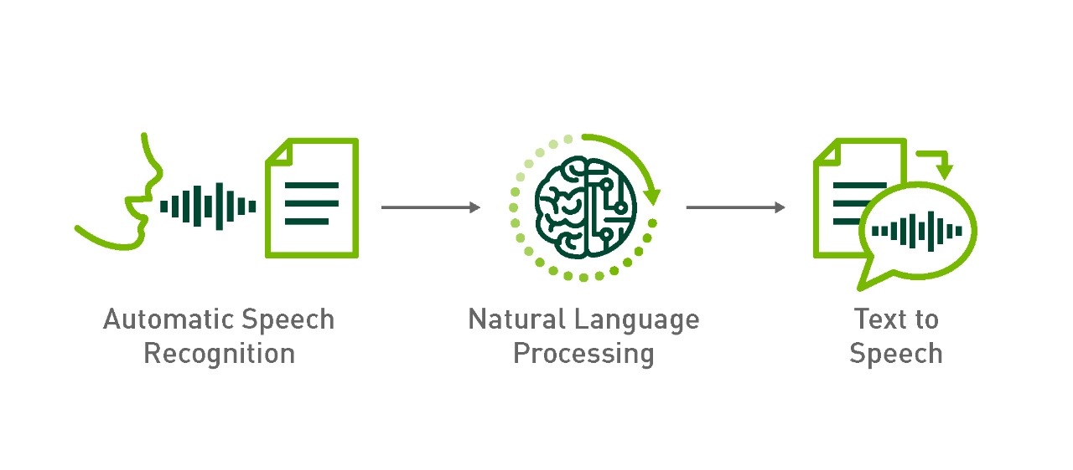
The following are the software requirements of our project :-
We used the stable version of python i.e python 3.7.
We used the Visual Studio Code IDLE to run our python program.
We used the following libraries or modules in our project –
1. Speech Recognition
2. pyttsx3
3. Pywhatkit
4. datetime
5. Wikipedia
6. Pyjokes
7. Os
8. Socket
9. Ecapture
10. Pyscreenshot
11. Weather Forecast
12. Web Browser

Slide 11
Development

Slide 12
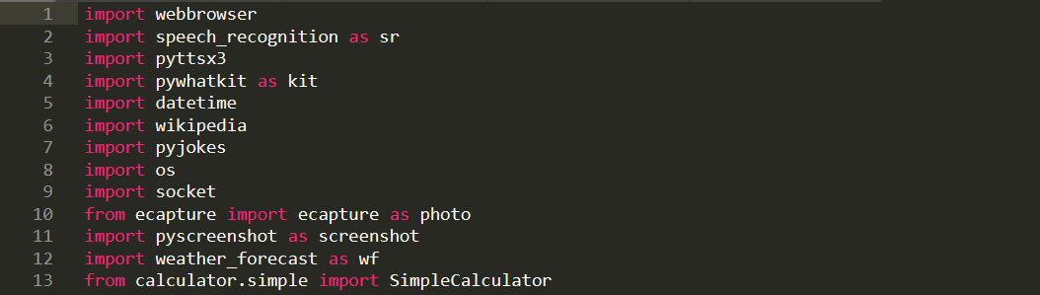
Code Part :-
We use the import function to import the required modules .The following module which have been imported has the various roles to play.
From the following modules we have 2 most important modules :-
1. Speech Recognition - This module is used to get the voice as the input using microphone.
2. pyttsx3 - This module is used to convert text-to-speech conversion library in Python. It works offline, and is compatible with both Python 2 and 3 version.

Slide 13
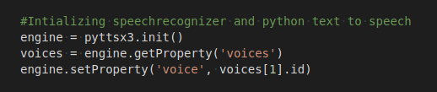
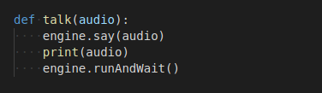
This part of code is used to take user voice as input and convert it into text format and stores. The other part i.e the ‘getProperty’ part changes the male voice to the female voice
The ‘talk’ function is used to get the output in audio format and after finishing the task it waits for the next insturction to be given by the user.

Slide 14
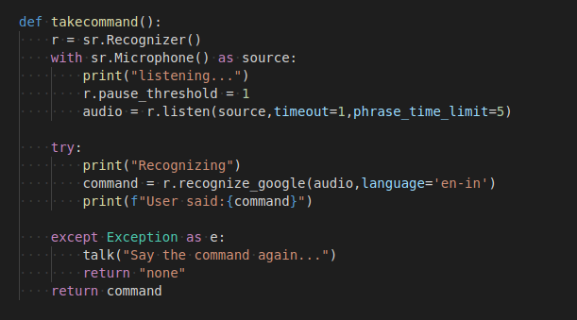
The ‘take_command’ function is used to initialize the microphone to listen the user’s voice and convert the voice to text. The audio input is converted using ‘recognize_google’ function.
If command is in appropriate it returns none and asks to say the command again.

Slide 15
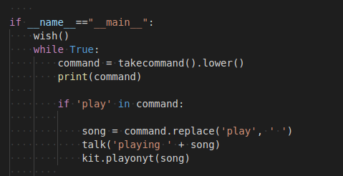

When user ask the virtual assistant to play the song it recognizes the ‘ play ’ word and goto Youtube , search for the song .
When user asks the virtual assistant for the time this part of the code recognize the ‘ time ’ word and gets the exact current time and gives the output to the user.

Slide 16

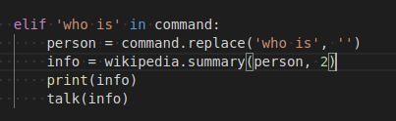
When user asks the virtual assistant for the date this part of the code recognize the ‘ date ’ word and gets the exact current date and gives the output to the user.
When user ask the virtual assistant to search about a person (eg. who is Donald Trump) it recognizes the word ‘ who is ’ and search for the information about the person in wikipedia and speaks 2 sentences about him.

Slide 17
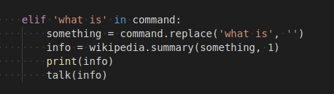

When user ask the virtual assistant to search about something (eg. what is Global Warming) it recognizes the word ‘ what is ’ and search for the information about the topic in wikipedia and speaks 2 sentences about it .
When user asks for a joke it recognize the word ‘ joke ’ and says a random joke by searching it in the browser.

Slide 18
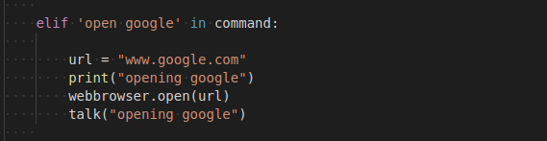
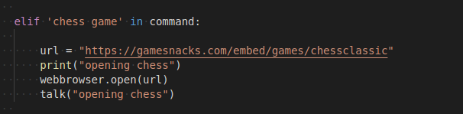
When user gives the command “open google” the virtual assistant opens the google in the default browser.
When user asks the virtual assistant to open chess game the word ‘chess game ’ is recognized by the assistant and open the game.

Slide 19
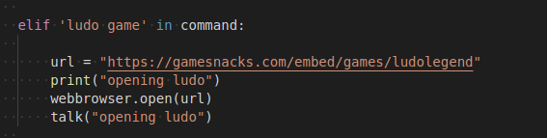

When user says to open ludo game ‘ludo game’ is recognized and the game is opend in the browser.
When the user says ‘open cmd’ the assistant uses the os module and open the command prompt.

Slide 20

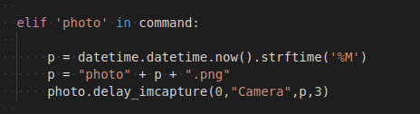
When the user want open notepad ‘open notepad’ is the command which opens the notepad when the command is given.
When user says to take a photo the word “photo” is recognized from the command and the camera is opened and automatically photo is taken and saved with the name “photo current minute with png extension”.(eg.photo12.png)

Slide 21
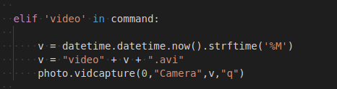
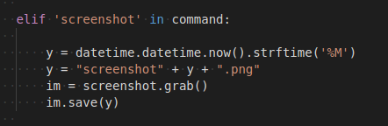
When user says to take a video the word “video” is recognized from the command and the camera is opened and automatically video is taken and saved with the name “video current minute with png extension”.(eg.video12.png). To stop the video we need to press the letter “q” from the keyboard which exit the camera.
When user want to take a screenshot teh word “screenshot” is recognized from the command and takes a screenshot and saves with the name “screenshot current minute with png extension”(eg. screenshot12.png)

Slide 22
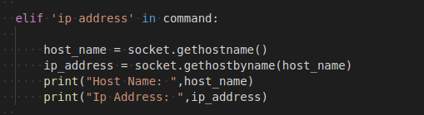
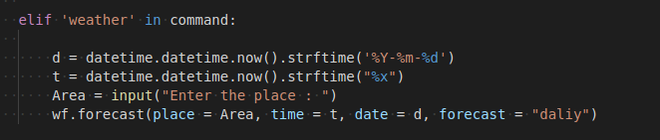
When we want to get the ip address the word “ip address” is recognized in the command and with the help of the os module the ip address and the host name is shown.
When user wan the check the weather , the word “weather ” is recognized and the current weather of the given area is shown.

Slide 23
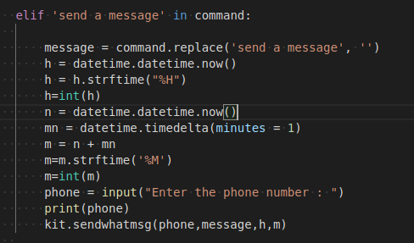
To send an whats app message the command ”send a message ” is message is used . After saying the command send a message rest of the part after the command is taken as the message, after taking the message the virtual assistant asks you to enter the phone number with the country code in it , after 20-25 second the message will be send. (We need to login our phone number in whatsapp web.)

Slide 24
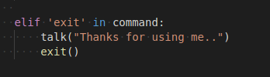
The exit command is used to exit the program or the virtual assistant.

Slide 25
Testing And Implmentation

Slide 26
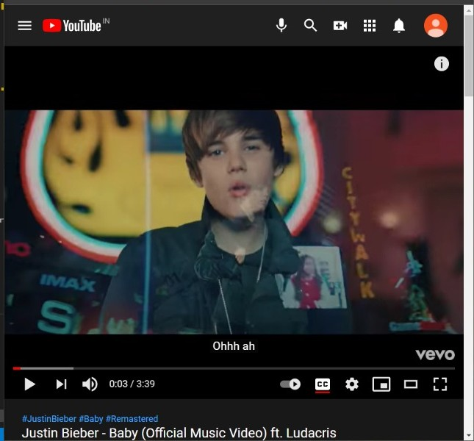
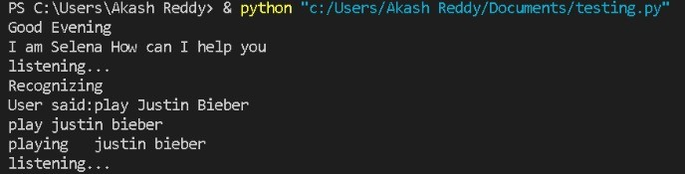
When user ask the virtual assistant to play a song
eg:- “play justin bieber”
It opens the youtube and play the song.

Slide 27
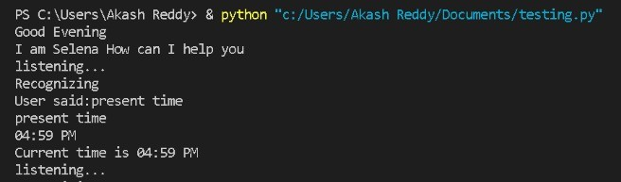
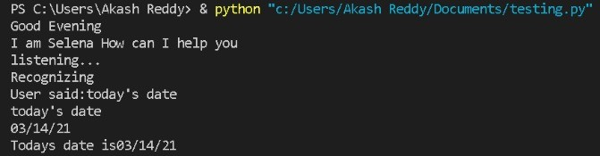
When user asks the time it gives the audio output and show the current time.
When user asks for the date it shows and also gives an audio output of it.

Slide 28
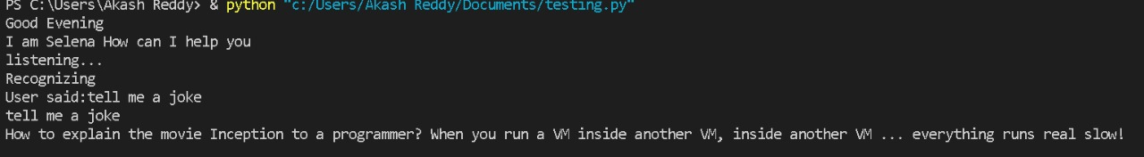
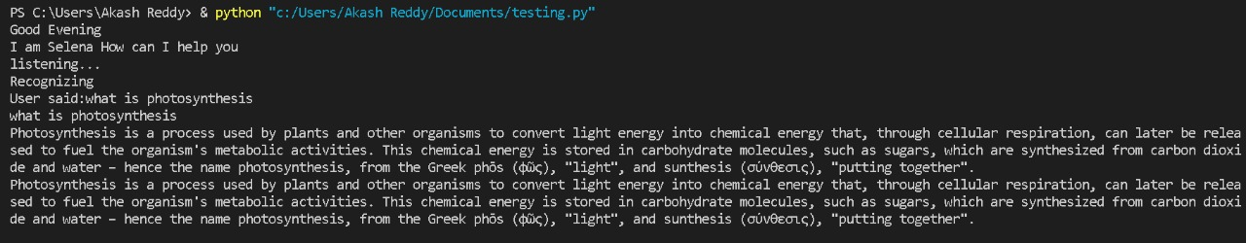
When user asks the assistant say a joke it goes to the web browser, select a random joke and gives the result in audio format.
When user asks for something like “what is photosynthesis” it goes to wikipedia , search about it and says 2 lines about it .

Slide 29
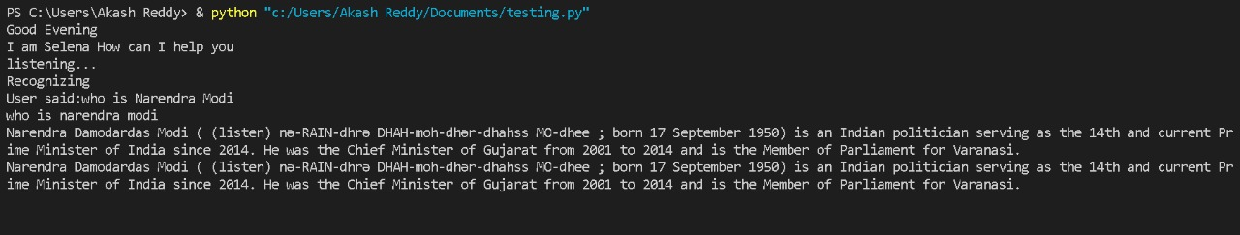
When user asks about a person like “who is Narendra Modi ” it goes to wikipedia , search about the person and says 2 lines about him .

Slide 30
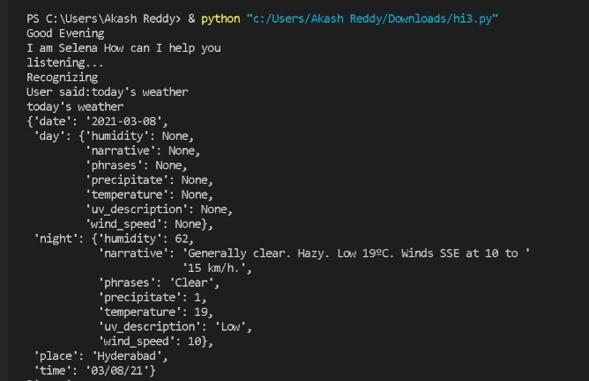
When user asks about today’s weather it shows today’s weather and gives audio output.

Slide 31
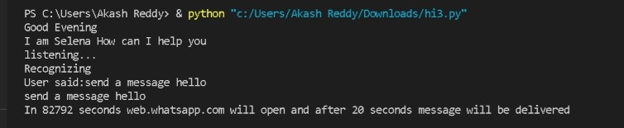
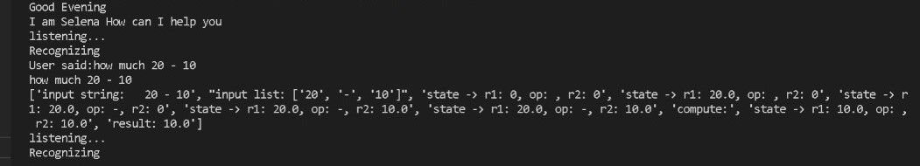
When user asks to send a message, it sends the message.
When user asks to calculate something it takes the input and gives the result.

Slide 32
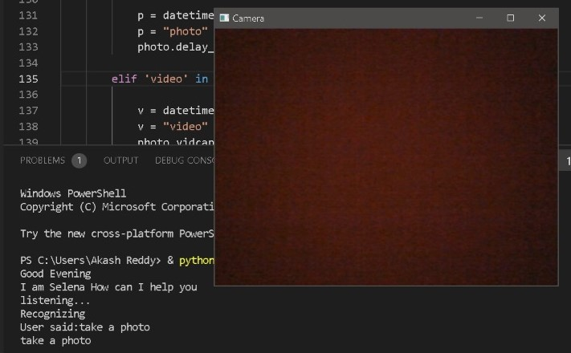
When the user asks to take a photo, it clicks the photo and displays it.

Slide 33
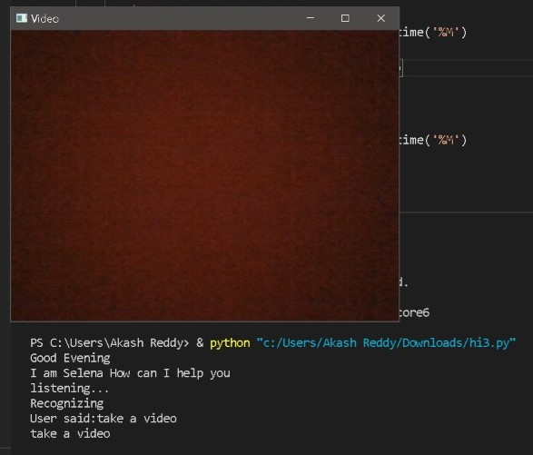
When the user asks to take a video, it records a video.

Slide 34
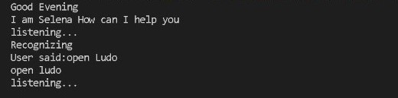
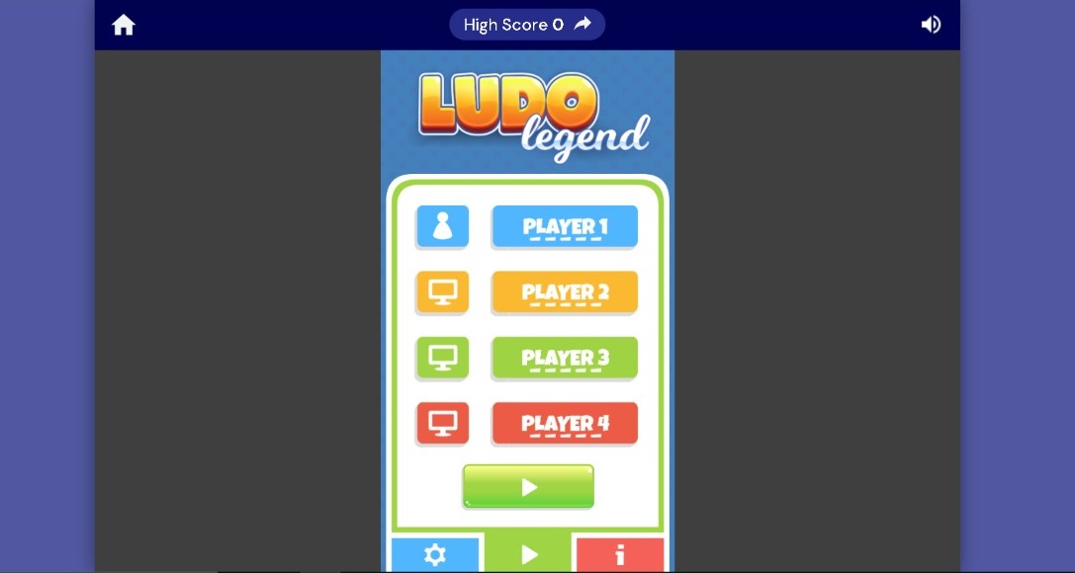
When user asks to open ludo, it opens it.
Output:

Slide 35
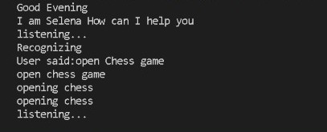
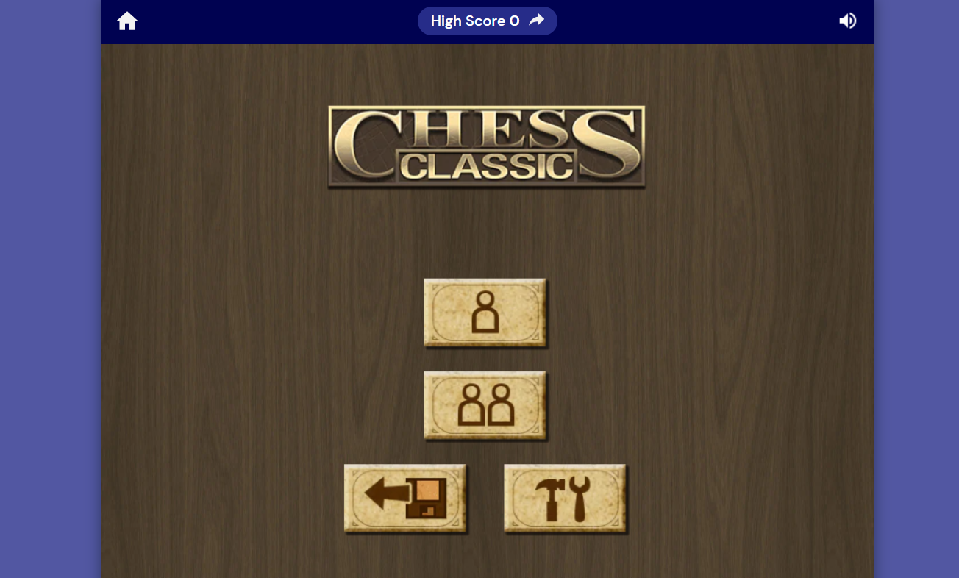
When user asks to open chess, it opens that game.
Output:

Slide 36
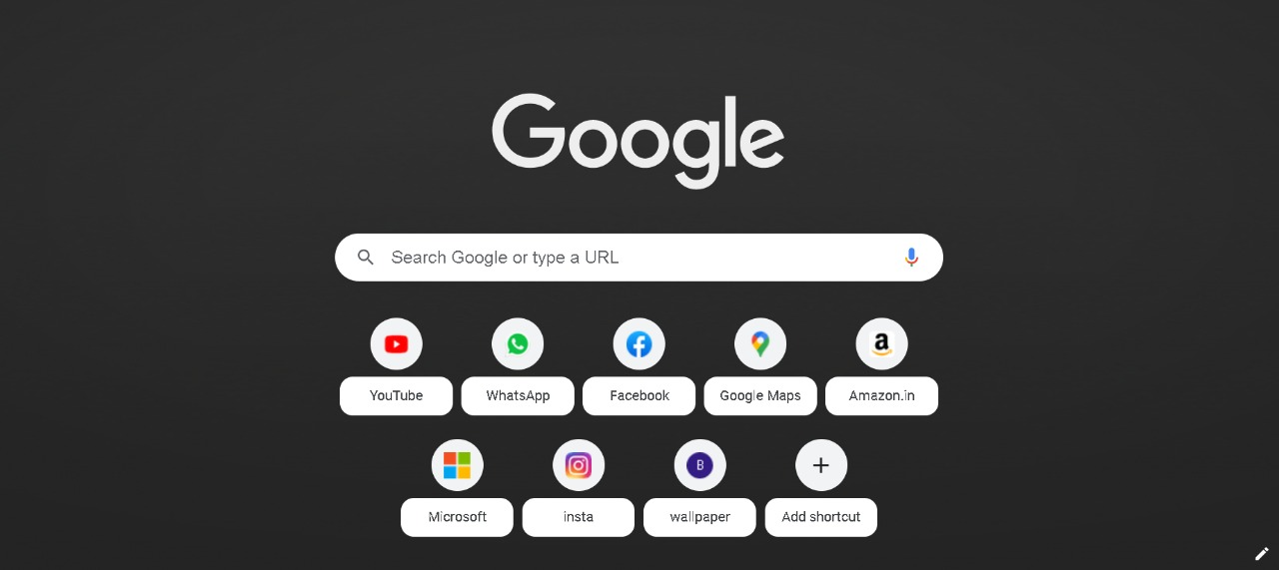
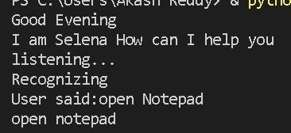
When user says open google the google tab is opened.

Slide 37
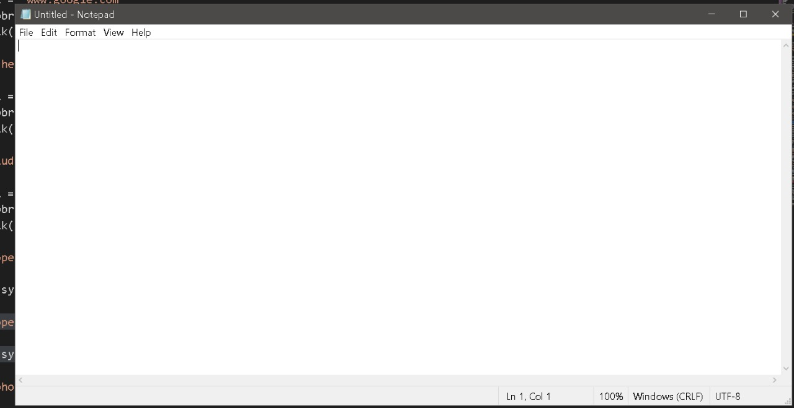
When user asks to open notepad the notepad is opened.

Slide 38
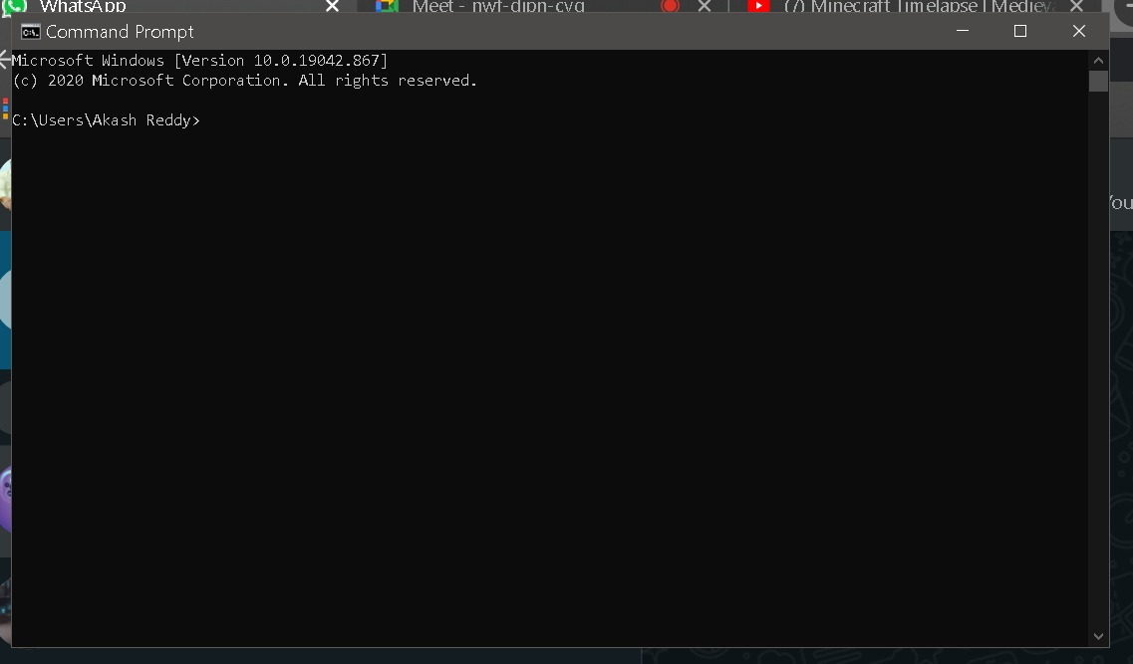
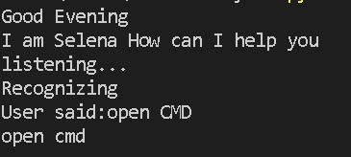
When user says to open command prompt the command prompt is open.

Slide 39
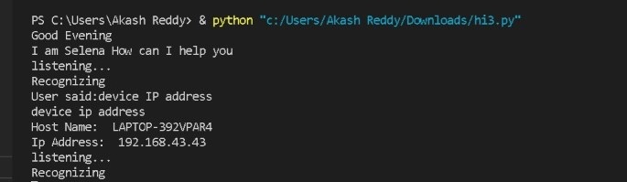
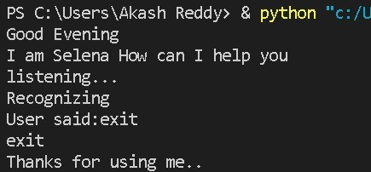
When user asks for the device’s IP address, it processes the input and displays the Host name and the device’s current IP address
When we dont want to use the assistant and the user says exit it stops the program and exit it.

Slide 40

THANK YOU

